Slide 1
!!! Please remove all client logos and references before sharing any case study with customer !!!

Slide 2
ITAU: Transform Accounts Platform monolith into cloud native architecture
Modernized Account platform lays the foundation to rapidly respond to changing Industry and market landscape; it also addresses technology and process constraints of legacy components (e.g. chose instant settlement over nightly batch).
Functional use cases: Ledger Function on Cloud, Authorizer Function on Cloud, with incremental de-risked migration from Legacy code (with near real time reconciliation)
Non-Functional use cases: Distributed transaction management, database selection for multi-product ledger, data synchronization between cloud native and mainframe through coexistence.
MVP Candidates: Authorizer Microservices, Cloud Native Architecture Ledger on Cloud Databases meeting the NFR requirements (Throughput, Response times, High Availability, Resiliency, Security), Coexistence architecture and proof of engineering for Data and Function Event Driven (Kafka based) Batch Update (VSAM Flip Flop to Postgres DB)
Notes:
ITAU Brazil

Slide 3




Itaú Account Platform Modernization journey
Business
Functions
Full Authorizing
of Individual Account
Authorizer++
Ledger++
Balance & Statement+
Tariff
Future…
Account Platform On
Mainframe
Ledger on Cloud
(Savings Account)
Authorizer
Ledger
Ledger on Cloud
(Savings Account, Current Account)
Balance & Statement
Account on Cloud
and Sync in Place
Coexistence
Data Synchronization
Online (X0)
Batch (Postings)
c
Coexistence++
Lifecycle Management
Observability
Coexistence
Coexistence+
Batch (Annotation and Reversal Postings)
Legacy Inbound
Legacy Outbound
Cloud
Platform
c
Multi-region
Multi –DC On-Prem Cloud with OpenShift
On-Prem Cloud
Multi-DC On-Prem Cloud
with OpenShift
+
AWS
Multi-DC On-Prem Cloud
with OpenShift
AWS with OpenShift
+
c
Design
for NFRS
Performance and Scalability
Security
High Availability
Resiliency
KPIs & Metrics
Notes:
ITAU Brazil

Slide 4










ITAU- architecture is designed for coexistence and interoperability on hybrid cloud
New Microservice for new outside-in function
Microservice for Inside-Out replacing existing function
Business logic (with or without data persistence)
Microservice for outside-In correlated
with existing function
Data “unlocked” from legacy taken to cloud-native in different form
Channels
REDEX
TEF
Authorizer
Ledger
Future Accounts Fn.
Fraud
Other..
Cloud-Native
Business Functions + C-I
Coexistence-Interoperability
Event Stream
CDC
API
Adaptors
Process Orchestration
Messaging
GRBE
Batch
VSAM
Z-CDC Plugin
…
…
Z/API
Account Systems (x0 …)
Fraud
(AQ5)
Other …
Legacy
SOR / MF
Core Accounts System
Platform

Slide 5

Target Architecture –Itaú Accounts Platform with Bank as a Service model
Tenants
Plataformas Gerenciadas pelo Itaú
Clientes de Plataformas Itaú
Operações Canal + Aplicações Itaú
Market Place Plataformas Itaú
Operações Canal + Aplicações Cliente
Conta p/ Clientes Itaú
Autorização:
Prod. Contas Produtizado
Lancto. Definitivo
Tena
Conta
Prod. Contas do Cliente
Prod. Contas do Cliente
Prod. Contas do Cliente
Conta Poupança
Conta Corrente
LIS
AD
LIS Adicional
Aplic. Aut.
Fundo Resgate Automático
Produto de Conta do Cliente
Produto de Conta do Cliente
<<Prod. de Conta>>
<<Prod. De Conta>>
<<Prod. de Conta>>
<<Prod. de Conta>>
<<Prod. de Conta>>
<<Prod. de Conta>>
<<Prod. de Conta>>
<<Prod. de Conta>>
<<Prod. De Conta>>
...
...
...
...
<<Ledger>>
Conta Poupança
<<Ledger>>
Conta Corrente
<<Ledger>>
LIS
<<Ledger>>
AD
<<Ledger>>
LIS Adicional
<<Ledger>>
Aplic. Aut.
<<Ledger>>
Fundo Resgate Aut.
<<Ledger>>
Produto de Conta do Cliente
<<Ledger>>
Produto de Conta do Cliente
...
Produtos de Conta
Produtos de Conta – Overdraft com Lastro em
Crédito
Produtos de Conta – Overdraft com Lastro em Investimentos
Outros Produtos de Conta
(Ex.: Cashback de Loyalty)
Suporte ao Processamento de Produtos de Conta
Efic. Débito
...
Corporativo
Reporting
Fundos
Papéis Inv.
Garantias
Multi-Visão
Analytics
Fundos
Papéis Inv.
Garantias
Multi-Visão
Analytics
Cred. Liq.
Pré-Aprv.
Cred. Liq.
Pré-Aprv.
Contábil
Gerencial
Fiscal
Risco
Regulatório
Contábil
Gerencial
Fiscal
Risco
Regulatório
Infraestrutura
Notes:
ITAU, Brazil

Slide 6
ITAU Bold play innovation 1 – Ledger on Cloud
Foundation of client’s Bank as a Services platform
Distributed transaction manager across Accounts Function modules
Accounts Functions as “Product” with Microservices Architecture (Product Ledger as a Service)
Ledger function on Cloud with distributed ledger databases bound to individual accounts functions
Notes:
ITAU, Brazil

Slide 7
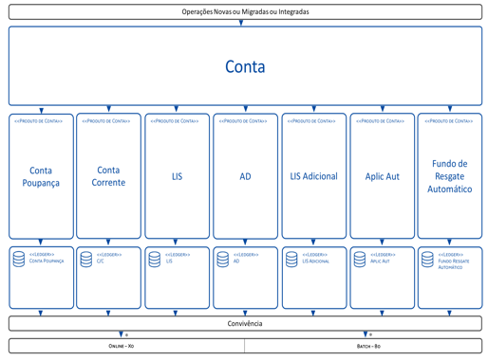
ITAU Bold Play Innovation 2 – Coexistence and Interoperability
Coexistence and Interoperability Services
Web
Toolkit
API
Gateway
Legacy Outbound
z/OS Connector
API Consumer
Legacy Environment
GRBE
Legacy Inbound
Online - X0
Online Update
Reconcile Function
Reconcile Function
SCA
SCB
Processing Key, Control
Ingestion Control
Data Integrity, Sync Audit
LCD
LCB
Posting Annotations
Postings, Annotation
Batch – B0
Event Streams
Event Streams
LTR
CDC
Batch Data Transfer
LTR
LVS
Batch Update
LTR
Messaging
LTR
Messaging
Online Data Transfer
Legacy Infrastructure
Coexistence Dev-Sec-Ops
Cloud Platform
IBM Z Infrastructure
Business Function
Technical Components
Notes:
ITAU Brazil

Slide 8
19 years of long lasting relationship – delivering multiple technical and business critical initiatives for Scotiabank
IBP development for branch front end integration
Start of AMS Services for Caribbean operations- Core Banking.
TSYS to FDR Conversion,
Establishment of Remote GDC,
Application
Conversion
110+ CIC India practitioners across multiple technologies
Internet Banking LEAP Retail
1998
2000, 2002
2007, 2008
2004, 2005
Data Centre Consolidation,
Credit Card Automation, Credit Bureau
FRS
Regulatory reporting for Caribbean
CI/CD enablement for ScotiaGlobe, Core Banking modularization
Start of prod support for Canadian Banking,
MDM Support,
EDW support, FTM
2008
2017
2018
Internet Banking LEAP CMS
24/7 Activation
2009
2013
Power6 Upgrade, PISCO, NIR & 3Digit Teller, IPS
2010
2011
2016
Core Banking Application Migration & Integration,
Credit Risk Programs,
2012
2014
2015
LPAR Split & FDIC
Debit card Fraud Monitoring (PRM)
QAT Environment Support, Optimized release implementation process, FATCA, EC Split
End to End Cheque operations,
SOA Foundation, RDARR
New application Support.
IPS, POSH, GCS, IST
Notes:
Scotia Bank

Slide 9
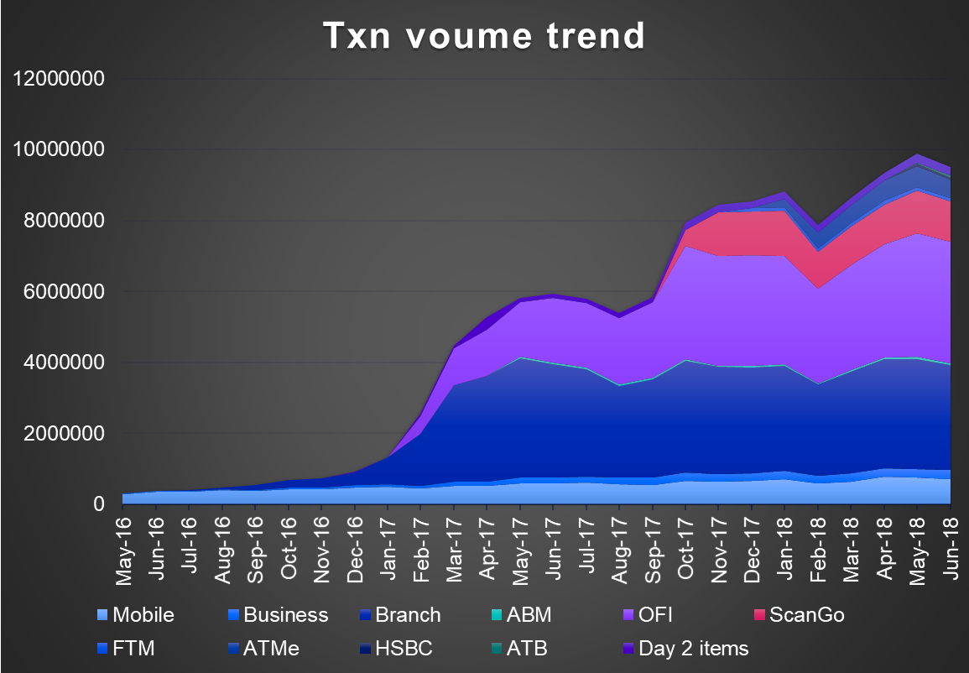

Key engagements – Delivering multiple AMS, Design & Build and Testing services, leveraging continuous improvement, to support Scotiabank on the digital transformation journey
24x7 Production Support for 26 countries for bank’s International Operations
An integrated team for Production Support, Application Development and Operational support
Up-skilling and cross-skilling of resources across applications and technologies to effectively support newer technologies and applications
Helping client with multiple key initiatives including – Enterprise Data Lake ingestion, Regulatory Reporting, CI/CD enablement and Core Banking Modernization
GBS Led FOAK End to End automated cheque processing involving IBM S/W, Infrastructure and AMS services
Helped bank to repatriate cheque processing from SYMCOR, saving cost
Supporting significant growth in cheque processing volume since rollout
Tangerine TCOE- A 3 Tier, Flexible capacity-based model Leveraging Local, Near shore and Offshore capability
Automated 85% of regression Testing
60% of Functional testers are re-skilled for Automation
Dynamic IVR: Test design using CTD helped reduce testing effort significantly gaining client’s confidence on CTD
1200 Initial estimated Test Cases | 6 weeks Schedule – Test design and Execution |  | 2722 Initial estimated hours
260 Optimized Test Cases - CTD | 78% Testing Effort Savings | ~ 810* Actual effort in hours | 95% Test Coverage with 0 Production defects
9
13 January 2025
© 2017 IBM Corporation
IBM Services
Notes:
Scotia Bank

Slide 10
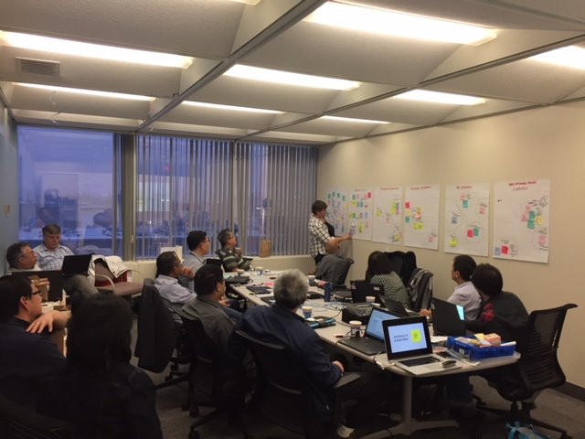
Scotia Bank - Driving CI/CD enablement and Core Banking Modernization through organized workshops to help achieve greater velocity
Align ScotiaGlobe with digital transformation initiatives, enabling CIAD
Modernize ScotiaGlobe into a modular system, with seamless integration to channels of engagement
Modernize data platforms, enabling data analytics and data as service
Optimize RUN vs CHANGE cost, Reduce overall cost of ownership
Key Objectives
We adopted a progressive and proven approach with planned activities and outcomes. Two weeks of strategy and discovery workshop was focused on enabling CI/CD and Core Banking modernization, aligning to bank’s key strategic objectives
Our Approach
Strategize
Discover
Execute
Innovate
2 weeks workshop
Leveraged IBM Design Thinking to prioritize pain points, ideate, and develop roadmap for CI/CD enablement
Engaged IBM experts from Rochester lab services to share modernization approach specific to IBM i
Continuing discussion with bank to fast track CI/CD enablement and implement on modernization roadmap
Activities and Next Steps
Notes:
Scotia Bank

